Slide 1
ChrisCruz.co
Overview
Consulting that ships
real systems
What you get
A clear plan + priorities
Working implementations (not theory)
Documentation your team can own
Simple metrics to track progress
Automation • Customer experience • Lead flow • KPI dashboards
$150/hour
Book a call →
ChrisCruz.co Consulting
© 2026
Notes:
[Sources]
- None (original content)
[Notes]
- Hourly rate $150/hr provided by client.

Slide 2
ChrisCruz.co
Why
COMMON BOTTLENECKS
Where businesses lose time and leads
Most teams don’t need “more tools” — they need a system that connects what they already use.
Manual busywork
Slow response times
No visibility
Copy/paste between tools
No clear owners for steps
Follow-ups slip through the cracks
Leads wait too long
Support queue grows
No triage or routing rules
KPIs aren’t defined
Reporting is inconsistent
Hard to decide what to fix next
Outcome: simpler operations, faster follow-up, clearer decisions
© 2026
Notes:
[Sources]
- None (original content)

Slide 3
ChrisCruz.co
Deliverables
DELIVERABLES
Built systems + clean handoffs
You get working workflows plus documentation so your team can own it.
Implementation deliverables
Team-ready documentation
Workflow map (current → future)
Automation blueprint + integration notes
Configured tools + tested flows
Edge cases + rollback plan
Owner/operator playbook
Escalation rules + QA checklist
KPI definitions + reporting cadence
“How to update it” guide
Deliverables scale with scope — always documented
© 2026
Notes:
[Sources]
- None (original content)

Slide 4
ChrisCruz.co
Services
CORE SERVICES
Four lanes that cover most businesses
Each engagement is scoped to measurable outcomes and practical ownership.
Workflow & Automation
Customer experience
Intake → follow-up → handoff
Routing, reminders, status updates
Admin reduction and consistency
Lead qualification flows
Support triage + escalation
Knowledge structure & QA
Growth & Lead flow
Dashboards & KPIs
Outreach + nurture sequences
Landing page messaging
Simple experiment loop
8–12 KPIs that matter
Owner-friendly dashboard
Weekly/monthly summary
If you’re unsure where to start, we begin with an opportunity audit.
© 2026
Notes:
[Sources]
- None (original content)

Slide 5
ChrisCruz.co
Examples
EXAMPLES
Work examples from our build together
These examples are from the website + multi-site architecture we just set up.
Multi-site website organization
ChrisCruz.co frontend build
Domain → site mapping via SITE_MAP
Templates namespaced per site
Static assets scoped per site
Clean, light design system
Services with examples + deliverables
Downloads section for docs/deck
Why this matters
One backend can serve multiple brands cleanly
Each site stays isolated (no asset collisions)
Easier maintenance and faster launches
This structure scales as you add more sites or landing pages.
© 2026
Notes:
[Sources]
- None (original content)

Slide 6
ChrisCruz.co
Process
HOW WE WORK
Simple process, fast execution
1
2
3
4
Discover
Plan
Build
Handoff
Confirm goals, tools, and highest-ROI opportunities.
Workflow map + success metrics + build outline.
Implement, test, and iterate (weekly checkpoints).
Docs + training + owner/operator playbook.
You always get a handoff doc that makes the work durable.
© 2026
Notes:
[Sources]
- None (original content)

Slide 7
ChrisCruz.co
Pricing
PRICING
Simple, transparent hourly billing
Rate: $150/hour. Scoped in hours with clear deliverables.
Advisory
Build sprint
Hybrid
2–4 hours/week
System planning + oversight
Review + QA + next steps
20–60 hours total
Implementation + testing
Documentation handoff
Sprint + light retainer
Improve & maintain
Quarterly refresh
What makes this work: clear scope, quick feedback loops, and ownership-ready documentation.
Invoices can be weekly or biweekly; projects are scoped in hours.
© 2026
Notes:
[Sources]
- None (original content)
[Notes]
- Rate based on client input.

Slide 8
ChrisCruz.co
Next steps
NEXT STEPS
If you want to move fast
Send three items and we’ll start with a tight first sprint.
Send these (copy/paste)
Downloads for the website
Your top 3 goals (next 90 days)
Tools you use today (CRM, email, scheduling, support)
A short description of your current workflow
Services & Rate Card (PDF)
Overview Deck (PPTX)
Website Copy Guide (DOCX)
ChrisCruz.co • Contact via website form • Add booking link when ready
Thank you
Place files under static/chriscruzmoney/downloads/ to serve them.
© 2026
Notes:
[Sources]
- None (original content)

Slide 9
Selected Product Builds & Technical Capabilities
Each screenshot is annotated with implementation-level context, not just project names.

Slide 10
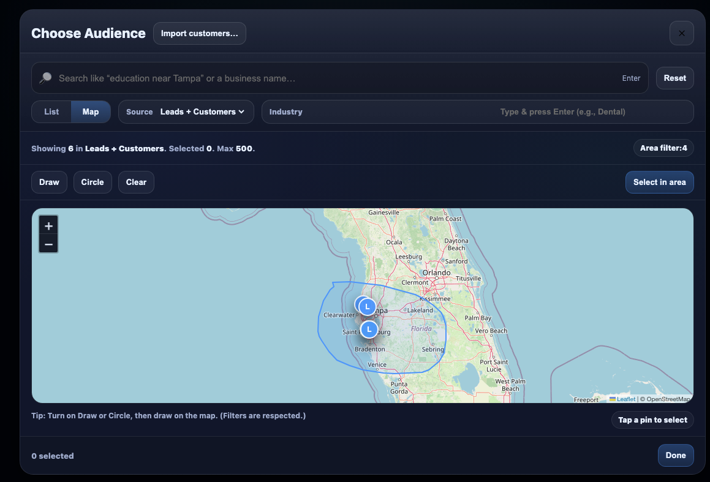
PIXI Email Studio — AI-Guided Campaign Editor
Prompt-to-email workflow with structured rewrite controls and live preview
LLM-assisted copy refinement with targeted modifiers (tone, urgency, CTA, offer).
Campaign metadata controls (audience size, schedule, device preview modes).
Composable UI architecture for template editing and rapid iteration before send.
Designed for high-volume outbound operations with brand-safe messaging control.

Slide 11
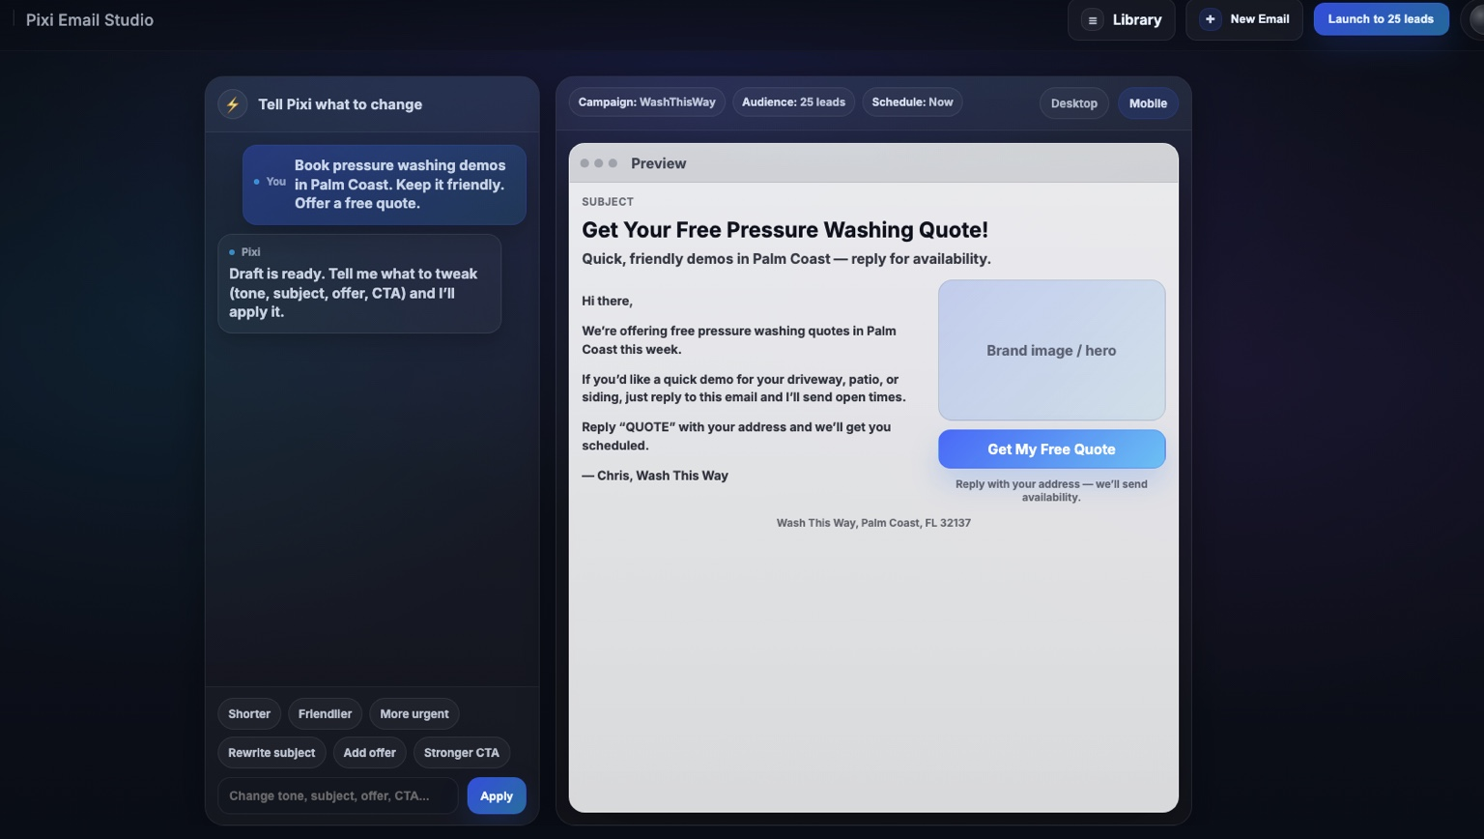
PIXI Audience Builder — Geospatial Lead Selection
Map-driven segmentation with radius/draw tools and constrained selection logic
Interactive map filtering pipeline (source, industry, geography) for lead targeting.
Spatial selection tools (draw, circle, area-select) integrated with lead constraints.
Supports import + enrichment workflows for leads and customer records.
Operational focus: reduce list noise and improve campaign relevance.

Slide 12
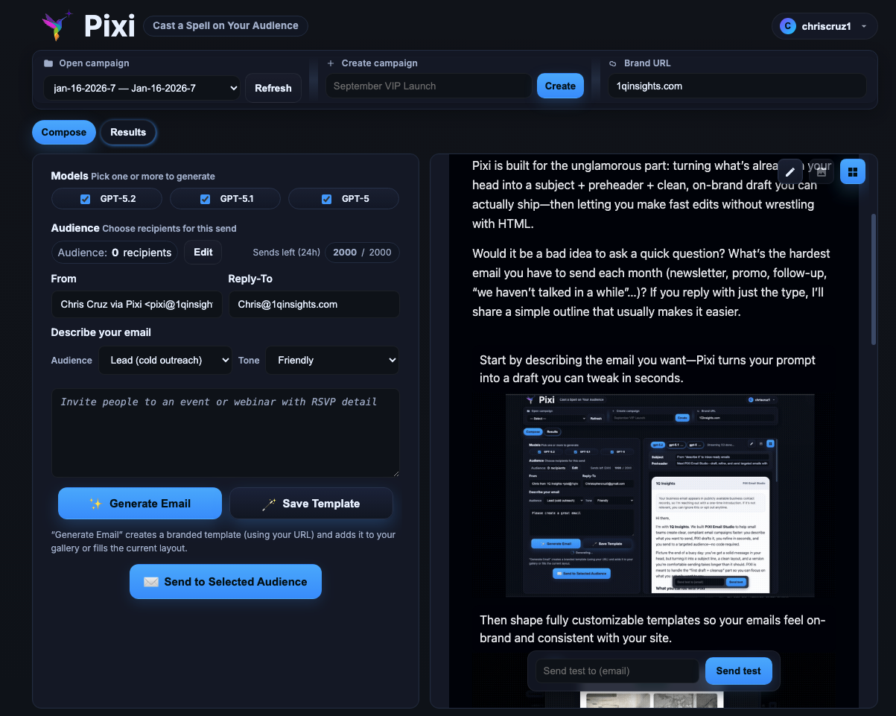
PIXI Operations Workspace — Compose, Validate, Launch
Unified send workflow that links prompt, generated content, and dispatch controls
Multi-model generation layer for draft creation and controlled variation.
Brand URL + sender/reply-to governance for deliverability consistency.
Preview-to-send pipeline with test/send actions in a single operational surface.
Built for production pacing: quick iteration without losing message quality.

Slide 13
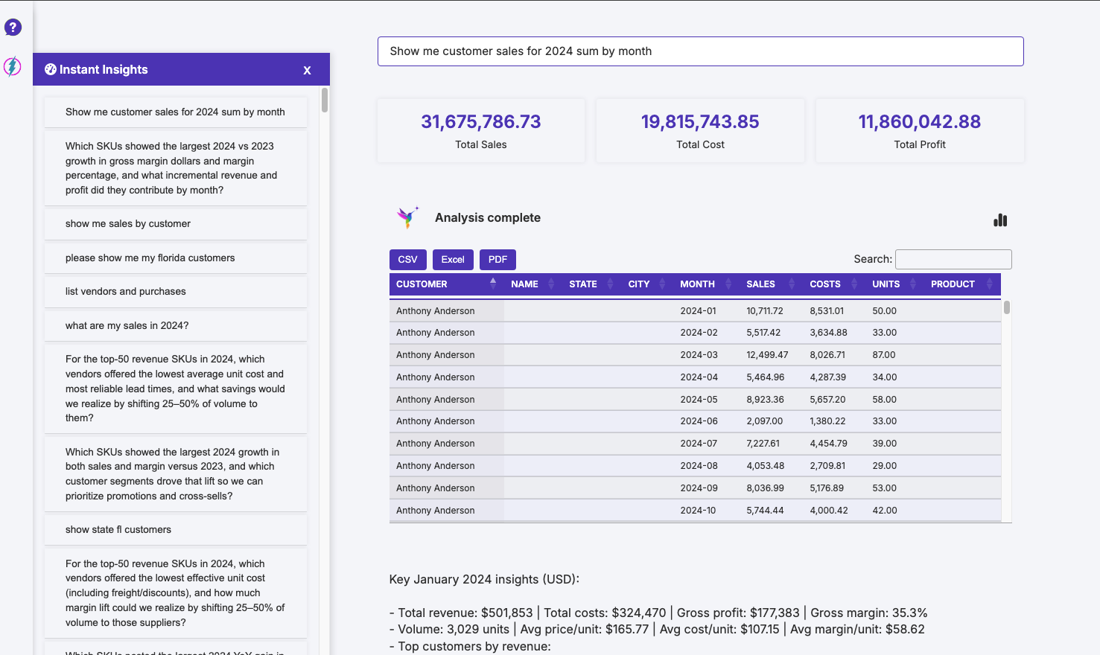
Instant Insights — Embedded Analytics Assistant
Natural language analysis layer over tabular business data
Prompt-to-analysis interaction model with KPI rollups and tabular drill-down.
Export pathways (CSV/Excel/PDF) for operational handoff and reporting.
Actionable insights generated from structured data with analyst-style framing.
Built for in-product decision support, reducing dependency on manual analysis.

Slide 14
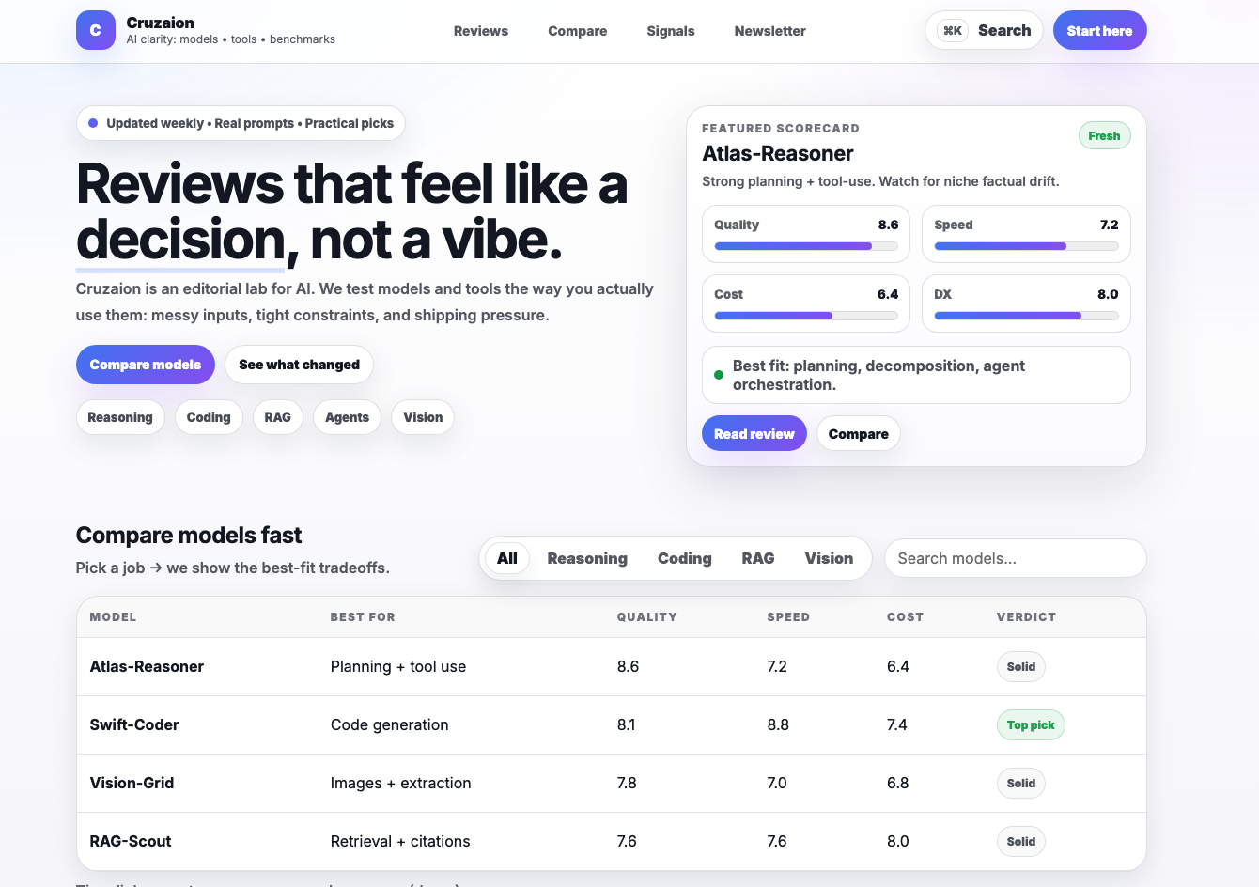
Cruzaion — Model Evaluation & Decision Intelligence UI
Comparative scoring framework for practical model/tool selection
Scorecard abstractions (quality, speed, cost, DX) for decision-grade comparisons.
Category filtering and searchable model grid for fast procurement decisions.
Editorial + metric blend to reduce ambiguity in AI tool selection.
Designed to support repeatable model-review workflows, not one-off opinions.

Slide 15
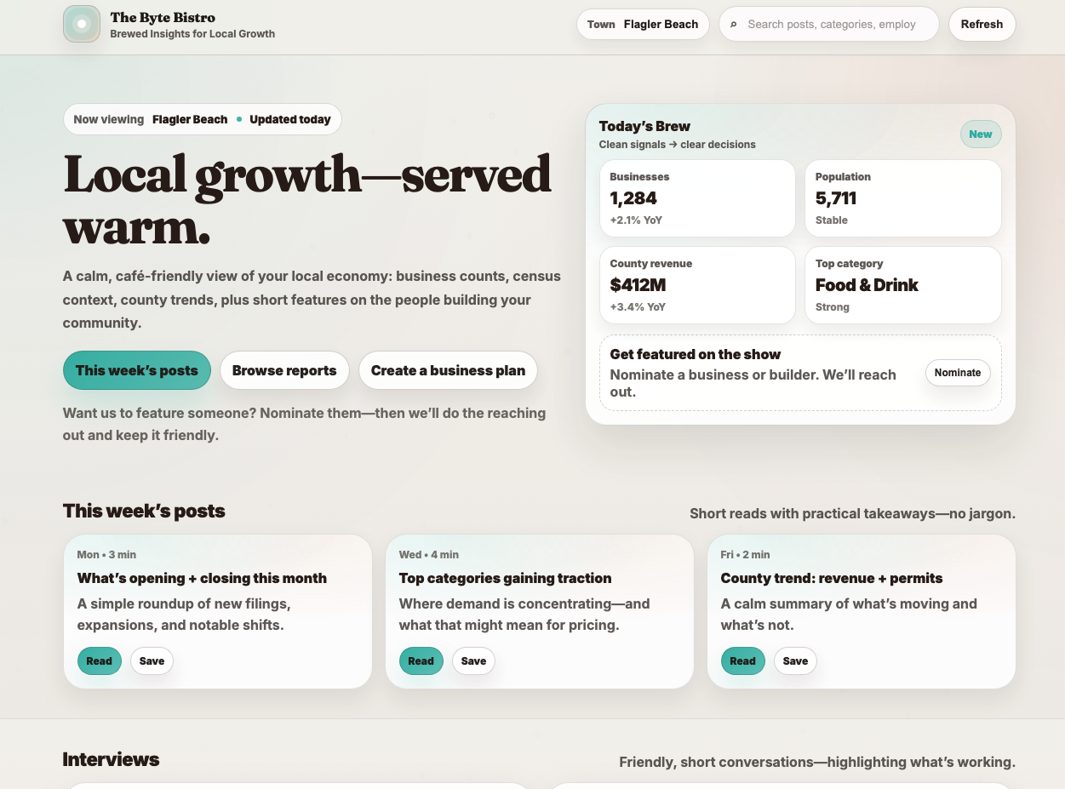
The Byte Bistro — Local Data Storytelling Platform
Community-focused analytics interface with editorialized business insights
Lightweight data cards for county metrics, sector signals, and trend summaries.
Content architecture mixing short-form reports, interviews, and practical takeaways.
Readable UX tuned for non-technical stakeholders and local business audiences.
Demonstrates product thinking for insight delivery, not just dashboarding.

Slide 16
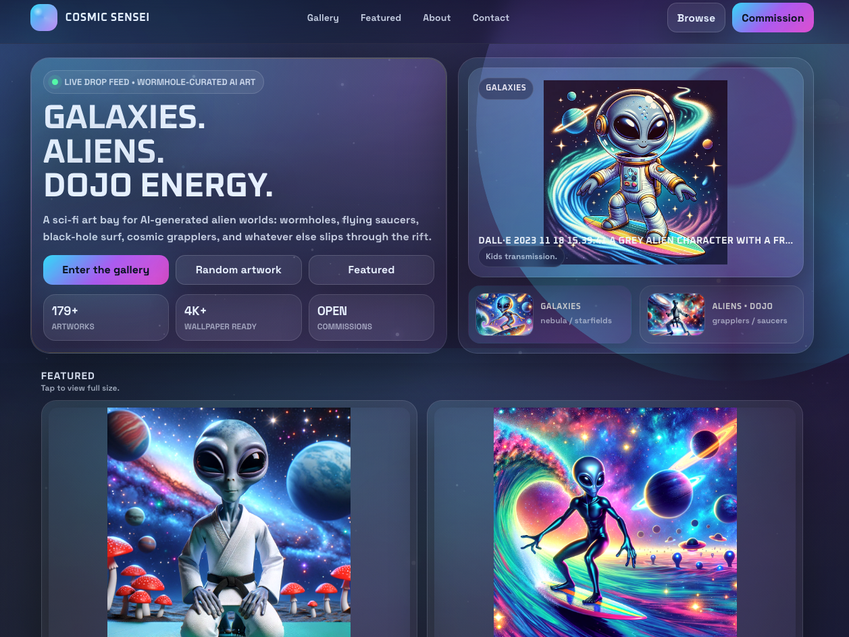
Cosmic Sensei — Visual Content Commerce Experience
Creative gallery system with categorization, featured content, and commission funnel
Content taxonomy (gallery/featured/categories) for browse + discovery behavior.
Visual merchandising pattern with prominent conversion points (commission CTA).
Performance-conscious card layout supporting media-rich browsing flows.
Shows ability to blend creative branding with structured product navigation.

Slide 17
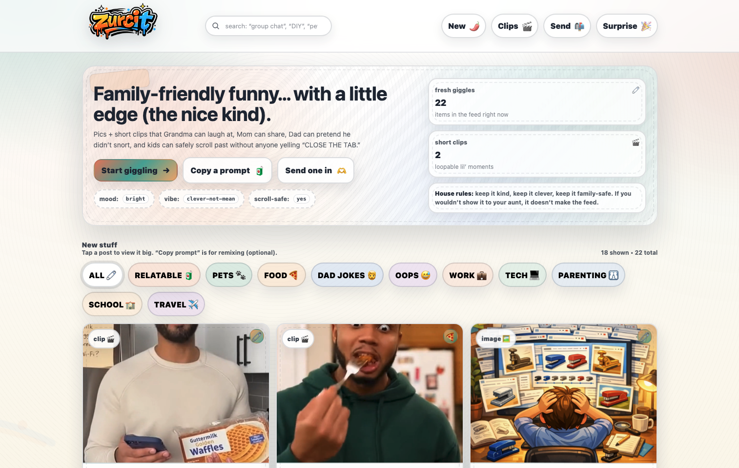
Zurcit — Family-Safe Media Feed Product
Moderation-aware humor feed with category chips and mixed media cards
Feed-oriented UX with category segmentation and scroll-safe content framing.
Blended image/clip cards designed for quick engagement and safe sharing.
Tone system and UI copy designed for broad household audiences.
Illustrates content product design for retention + trust.

Slide 18
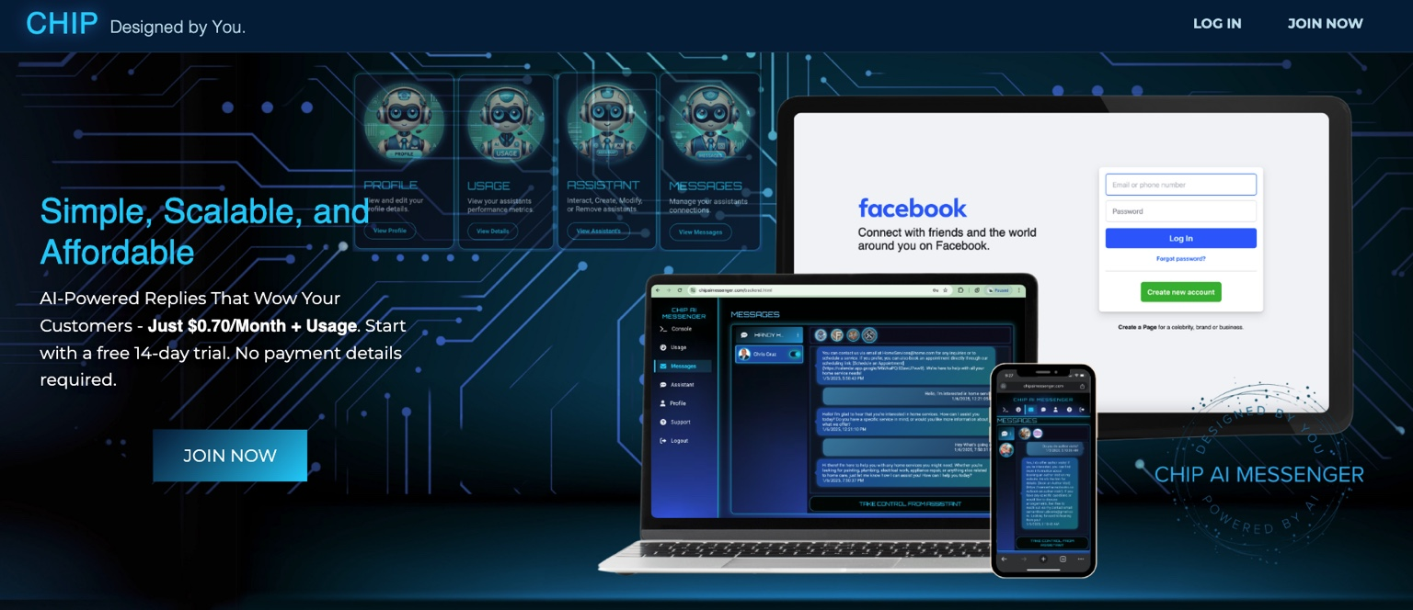
CHIP AI Messenger — Omnichannel Support Automation (Legacy)
Early customer-service automation surface integrating messaging workflows
Conversation automation for response handling and support experience continuity.
Cross-device interface presentation (desktop + mobile messaging context).
Foundational architecture that informed later production-grade systems.
Included as legacy proof of long-term product iteration and delivery history.

